Slide 1

Timer and Indicators
Emerging Technology : Flutter
Week 5
Program Studi Teknik Informatika
Fakultas Teknik – Universitas Surabaya

Slide 2

SIMPLE TIMER
01

Slide 3

Timer
Some kind of clock to measure time intervals
Two types:
  Stopwatch: count upwards from 0 to measure elapsed time
  Timer: counts down from a specified time

Slide 4
Preparation
import 'package:flutter/material.dart';
class Quiz extends StatefulWidget {
const Quiz({super.key});
@override
State<StatefulWidget> createState() {
return _QuizState();
}
}
class _QuizState extends State<Quiz> {
int _hitung = 0;
@override
Widget build(BuildContext context) {
return Scaffold(
appBar: AppBar(
title: const Text('Quiz'),
),
body: Center(
child: Column(children: <Widget>[
Text(_hitung.toString(),
style: const TextStyle(
fontSize: 24,
)),
])),
);
}
}
We will implement timer in a simple Quiz screen. The screen will interact with user and dynamically changing. Therefore, we make it as a stateful widget. Add a menu in drawer to open it.

Slide 5
Create Timer
Timer need import 'dart:async’;
import 'dart:async’;
==================
late Timer _timer; // add “late” to initialize it later in initState() @override
void initState() {
super.initState();
_timer = Timer.periodic(Duration(milliseconds: 1000), (timer) {
setState(() {
_hitung++;
});
});
}
@override
void dispose() {
_timer.cancel();
_hitung = 0;
super.dispose();
}
Timer jalan perdetik / 1000 milliseconds
Timer dimatikan jika state ditutup/destroy/dispose biar penggunaan memori lebih efisien

Slide 6
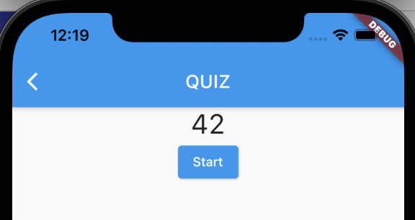
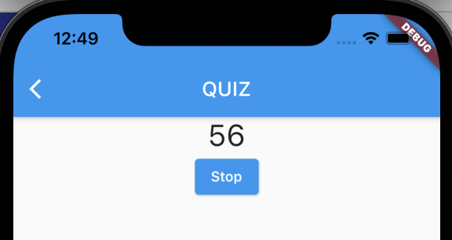
Stop and Start button
Don't forget to add menu in drawer to access this quiz screen (main.dart)
To Stop timer you can use:
_timer.cancel();
Can you add stop button to stop the timer?
Can you add start button to start again the timer?
Can you make those above button replacing each other?
  Hint : use ? and : syntax 🡪 Condition ? When true : when false

Slide 7
Solution
ElevatedButton(
onPressed: () {
setState(() {
_timer.isActive ? _timer.cancel() : startTimer();
});
},
child: Text(_timer.isActive ? "Stop" : "Start")
)

Slide 8
COUNTDOWN TIMER
02

Slide 9
Countdown timer
Countdown timer can be made by setting up the counter timer by a certain number.
When the timer ticks, the counter variable is reduced.
Usually when the counter reaches 0, an event is raised.
For example: raising an alert and stopping the game.
Can you change our previous timer with a countdown timer with initial value of 100? Stop the timer and give an alert (see AlertDialog from last week) when the timer variable reaches 0.

Slide 10
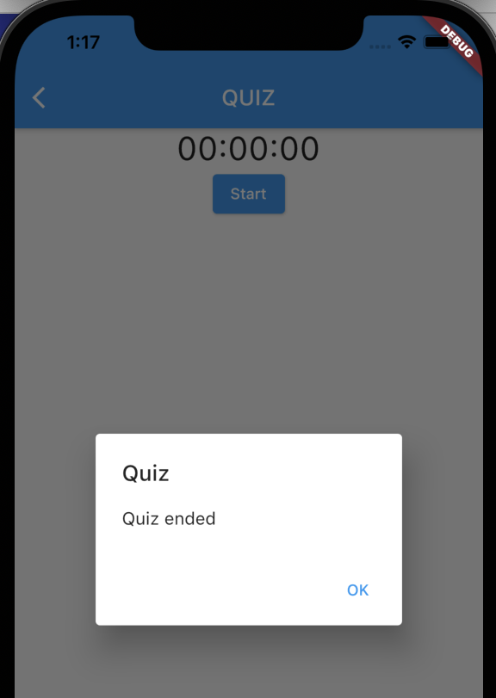
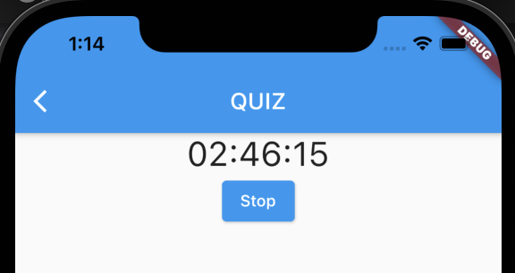
hour:minute:second
Usually, countdown timer is shown in hour:minute:second format.
You can calculate the timer value with this function
String formatTime(int hitung) {
var hours = (hitung ~/ 3600).toString().padLeft(2, '0');
var minutes = ((hitung % 3600) ~/ 60).toString().padLeft(2, '0');
var seconds = (hitung % 60).toString().padLeft(2, '0');
return "$hours:$minutes:$seconds";
}
~/ is a truncating division operator
The division will be rounded towards zero

Slide 11
Solution
set _hitung to random number, i.e: 1761.
use formatTime to format the time into hh:mm:ss
Fix the start/stop button
setState(() {
if (_hitung == 0) {
_timer.cancel();
showDialog<String>(
context: context,
builder: (BuildContext context) => AlertDialog(
title: Text('Quiz'),
content: Text('Quiz Ended'),
actions: <Widget>[
TextButton(
onPressed: () => Navigator.pop(context, 'OK'),
child: const Text('OK'),
),
],
));
} else {
_hitung--;
}
});

Slide 12
PERCENT INDICATORS
03

Slide 13
Percent Indicators
Sometimes, to make a counter more visually attractive, an indicator may be added.
We will use percent_indicator plugin in this example.
Add its dependency in pubspec.yaml
percent_indicator: ^4.2.5
and add import in the quiz screen.
import 'package:percent_indicator/percent_indicator.dart';
To learn more about this library, visit https://pub.dev/packages/percent_indicator

Slide 14
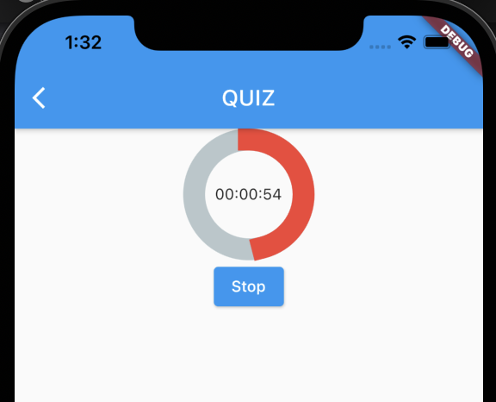
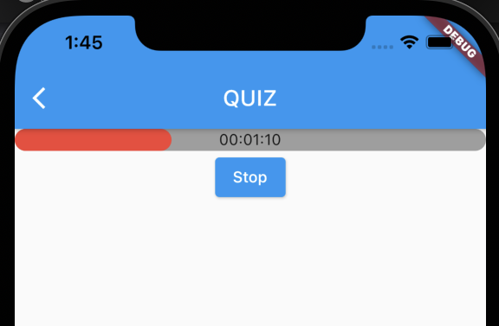
Circular and linear
Don’t forget create _initValue variable
CircularPercentIndicator(
radius: 120.0,
lineWidth: 20.0,
percent: 1 - (_hitung / _initValue),
center: Text(formatTime(_hitung)),
progressColor: Colors.red,
),
LinearPercentIndicator(
center: Text(formatTime(_hitung)),
width: MediaQuery.of(context).size.width,
lineHeight: 20.0,
percent: 1 - (_hitung / _initValue),
backgroundColor: Colors.grey,
progressColor: Colors.red,
),

Slide 15
MULTIPLE CHOICE QUIZ
04

Slide 16
Data Preparation
We will start to build our quiz by preparing the questions, equipped with its options and its answer. It will be easier using array of objects. Therefore, we prepare the class first:
class Question {
String narration;
String optionA;
String optionB;
String optionC;
String optionD;
String answer;
Question(this.narration, this.optionA,
this.optionB, this.optionC, this.optionD, this.answer);
}

Slide 17
Data Preparation (2)
Prepare the variable for storing the question, current question number, and the score.
Also add the questions variable with several data.
List<Question> _questions = [];
int _question_no = 0;
int _point=0;
=========================
Add this in initState():
_questions.add(Question("Not a member of Avenger ", 'Ironman','Spiderman', 'Thor', 'Hulk Hogan', 'Hulk Hogan'));
_questions.add(Question("Not a member of Teletubbies", 'Dipsy', 'Patrick','Laalaa', 'Poo', 'Patrick'));
_questions.add(Question("Not a member of justice league", 'batman', 'aquades','superman', 'flash', 'aquades'));
_questions.add(Question("Not a member of BTS", 'Jungkook','Jimin', 'Gong Yoo', 'Suga', 'Gong Yoo'));

Slide 18
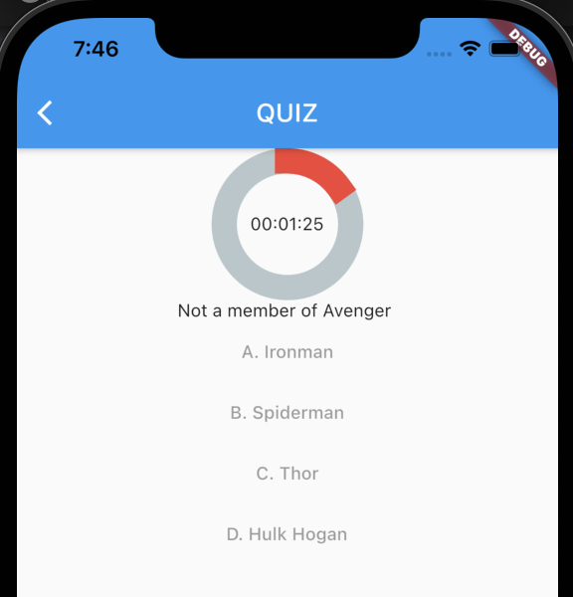
Add the interface
TextButton(onPressed: () { },
child: Text("A. ${_questions[_question_no].optionA}")),
TextButton(onPressed: () { },
child: Text("B. ${_questions[_question_no].optionB}")),
TextButton(onPressed: () { },
child: Text("C. ${_questions[_question_no].optionC}")),
TextButton(onPressed: () { },
child: Text("D. ${_questions[_question_no].optionD}")),

Slide 19
Exercise
Display next question when time is up
We will simulate the timer and question first. When timer is up, we will display next question, and timer will be maximum again and decreased gradually. When we already in the last question and timer is up, the game will stop.
It will be nice if you put code that handle end of the game in a function, because it will be called also from another event. do you know what the event is?

Slide 20
Adding onPressed
onPressed behaviour in each buttons are similar, except for the option text which the user selected. Therefore, it is more convenient if we use a function with parameter.
void checkAnswer(String answer) {
setState(() {
if (answer == _questions[_question_no].answer) {
_point += 100;
}
if(_question_no==_questions.length-1)
{
endGame();
}
else
{
//jika belum
_question_no++;
_hitung=_initValue;
}
});
}

Slide 21
Adding onPressed (2)
TextButton(
onPressed: () {
checkAnswer(_questions[_question_no].optionA);
},
child: Text("A. " + _questions[_question_no].optionA)),
TextButton(
onPressed: () {
checkAnswer(_questions[_question_no].optionB);
},
child: Text("B. " + _questions[_question_no].optionB)),
TextButton(
onPressed: () {
checkAnswer(_questions[_question_no].optionC);
},
child: Text("C. " + _questions[_question_no].optionC)),
TextButton(
onPressed: () {
checkAnswer(_questions[_question_no].optionD);
},
child: Text("D. " + _questions[_question_no].optionD)),
Add the player score in the modal dialog when the game is ended.

Slide 22
EXERCISE
05

Slide 23
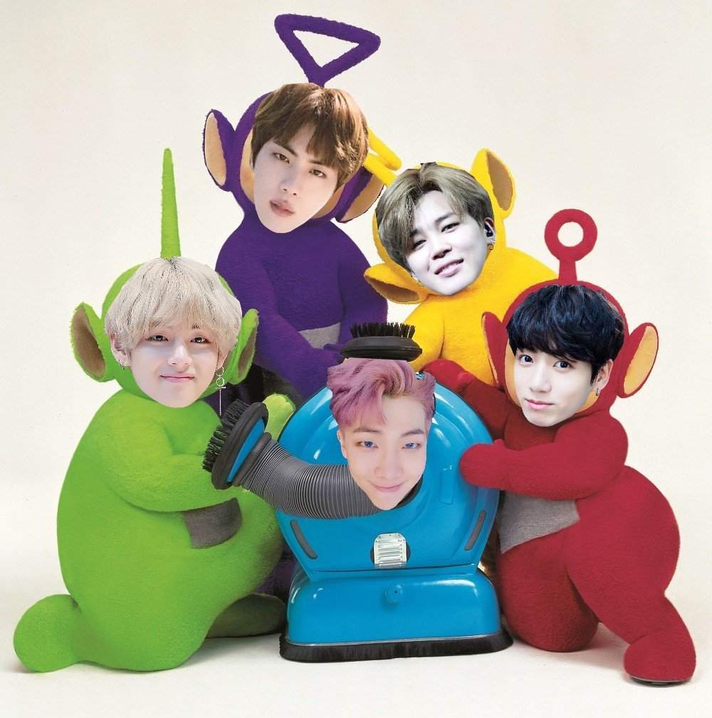
Adding Picture
Advanced challenge:
Add more question up to 10 questions, displays just 5 of them randomly.
For each question, display a picture related to the question.

Slide 24



